Slide 1
PERFECT STORM
My final bootcamp project – René Jansen
Notes:
In my childhood people were still talking about it

Slide 2
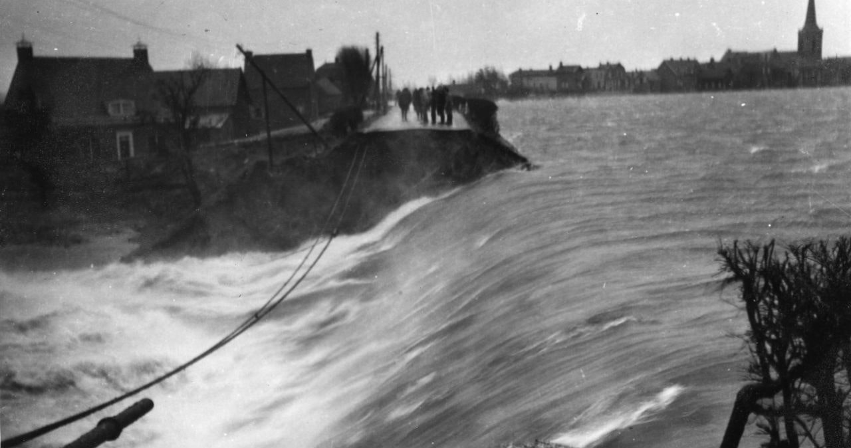
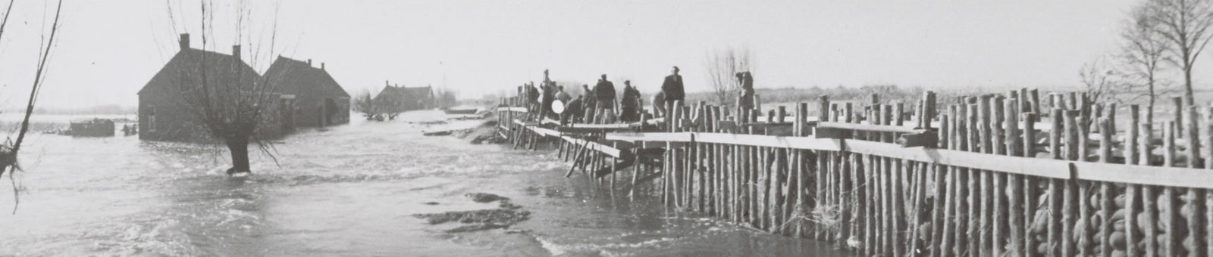
1953
Storm
North Sea
North-northwest
Spring tide
Flood defenses
Dike maintenance and monitoring
Notes:
In 1953 my country was hit by the biggest natural disaster in the Netherlands in the 20th century. On January 29 of that year a STORM developed between Iceland and Scotland. In the NORTH SEA, the wind turned to NORTH-NORTHWEST. The result was: a storm pushing up seawater of 1,000 km long that headed straight for our coast. On top of that: it was SPRING TIDE (...). FLOOD DEFENSES were mainly of a natural kind and, moreover, POORLY MAINTAINED and MONITORED, because the Netherlands had to be rebuilt after the second world war. Until then, dikes, dunes and quays had no priority.
In the night of 31st of January the unthinkable happened: the dikes in the province of Zeeland broke. While most people were asleep, the sea water rushed into the land. The consequences were disastrous: 1836 people died. 72000 people had to be evacuated. Livestock drowned and farming failed and much, much more I can say about this horrible disaster, but I want focus on the data analytics part of storm surges.

Slide 3
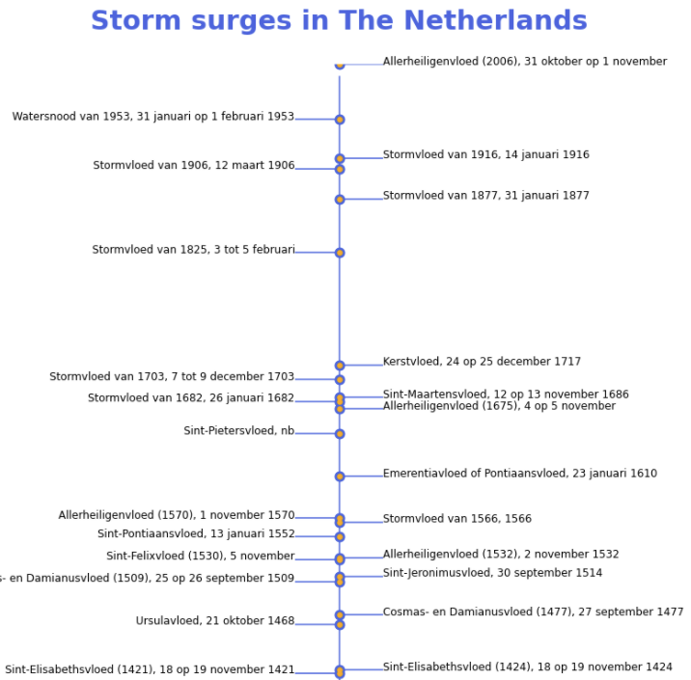
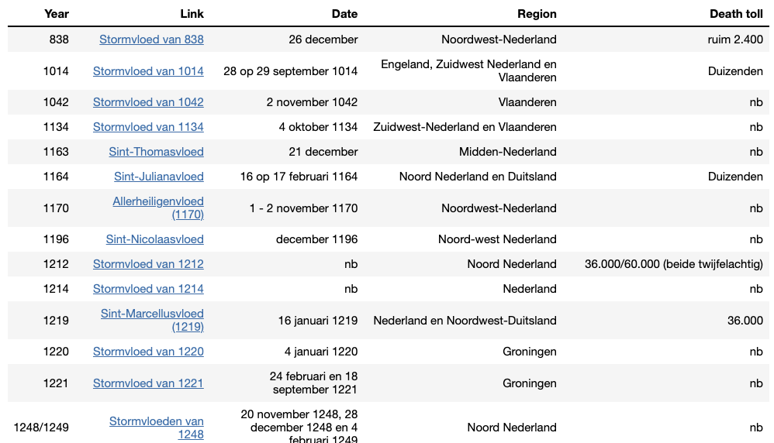
Before 1953
Notes:
For those who want to know more about HOW OFTEN in history the Netherlands has been hit by floods, I refer to my Jupyter notebook on Github. There you can see how I took all the storm surges from wikipedia and made a nice timeline with Python.
There is ALSO A TABLE with all the ruthless storms in Dutch history, nicely offered in HTML. Some even got a name. It’s in Dutch though …
In the previous slide I mentioned … Storm, The North Sea, North-northwest, Spring tide, Flood defenses and Dike maintenance and monitoring. These are the subjects of my presentations and obviously I collected data about this

Slide 4
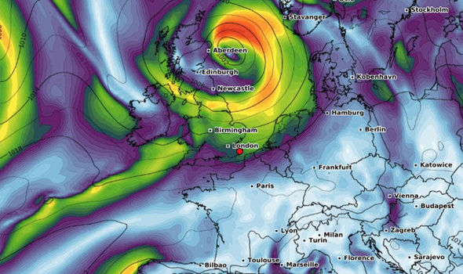
01
STORMS
October to March
North and South
6 Weather stations
Notes:
We all know that the storm season is from autumn to early spring, roughly from October to March, but did you know that temperature differences between the south of Europe and the north is an ideal breeding ground for storms?
That is why I collected temperature data from various weather stations and then calculate the averages for northern Europe and the south and also the delta between those. In the south I gathered temperatures around the Mediterranean for the locations:
LASTOVO, CROATIA - SEVILLA/SAN PABLO, SPAIN - MONTPELLIER-AEROPORT
And in the north of Europe:
WICK, UNITED KINGDOM - BERGEN/FLESLAND, NORWAY- VLISSINGEN, NETHERLANDS
It’s important to know that there is a time series dependency on this data: the theory is that there are larger differences of temperatures in the days before the storms. During the analysis I could not find a rule of thumb so I set the series to 7 days. The time series, averages and the delta I took as input in the model

Slide 5
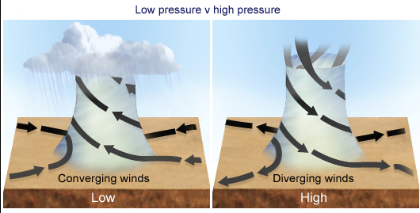
02
NORTH SEA
Atmospheric
Accelerating
4 Weather stations
Notes:
In addition to data analysis, I learned a lot about weather, such as why we measure barometric or atmospheric pressure. As with temperature, the difference between one side of the storm and the other is important. The greater the pressure difference (in hectopascals), the more likely the storm will accelerate. It will be fierce, especially low above the sea.
<next slide>

Slide 6
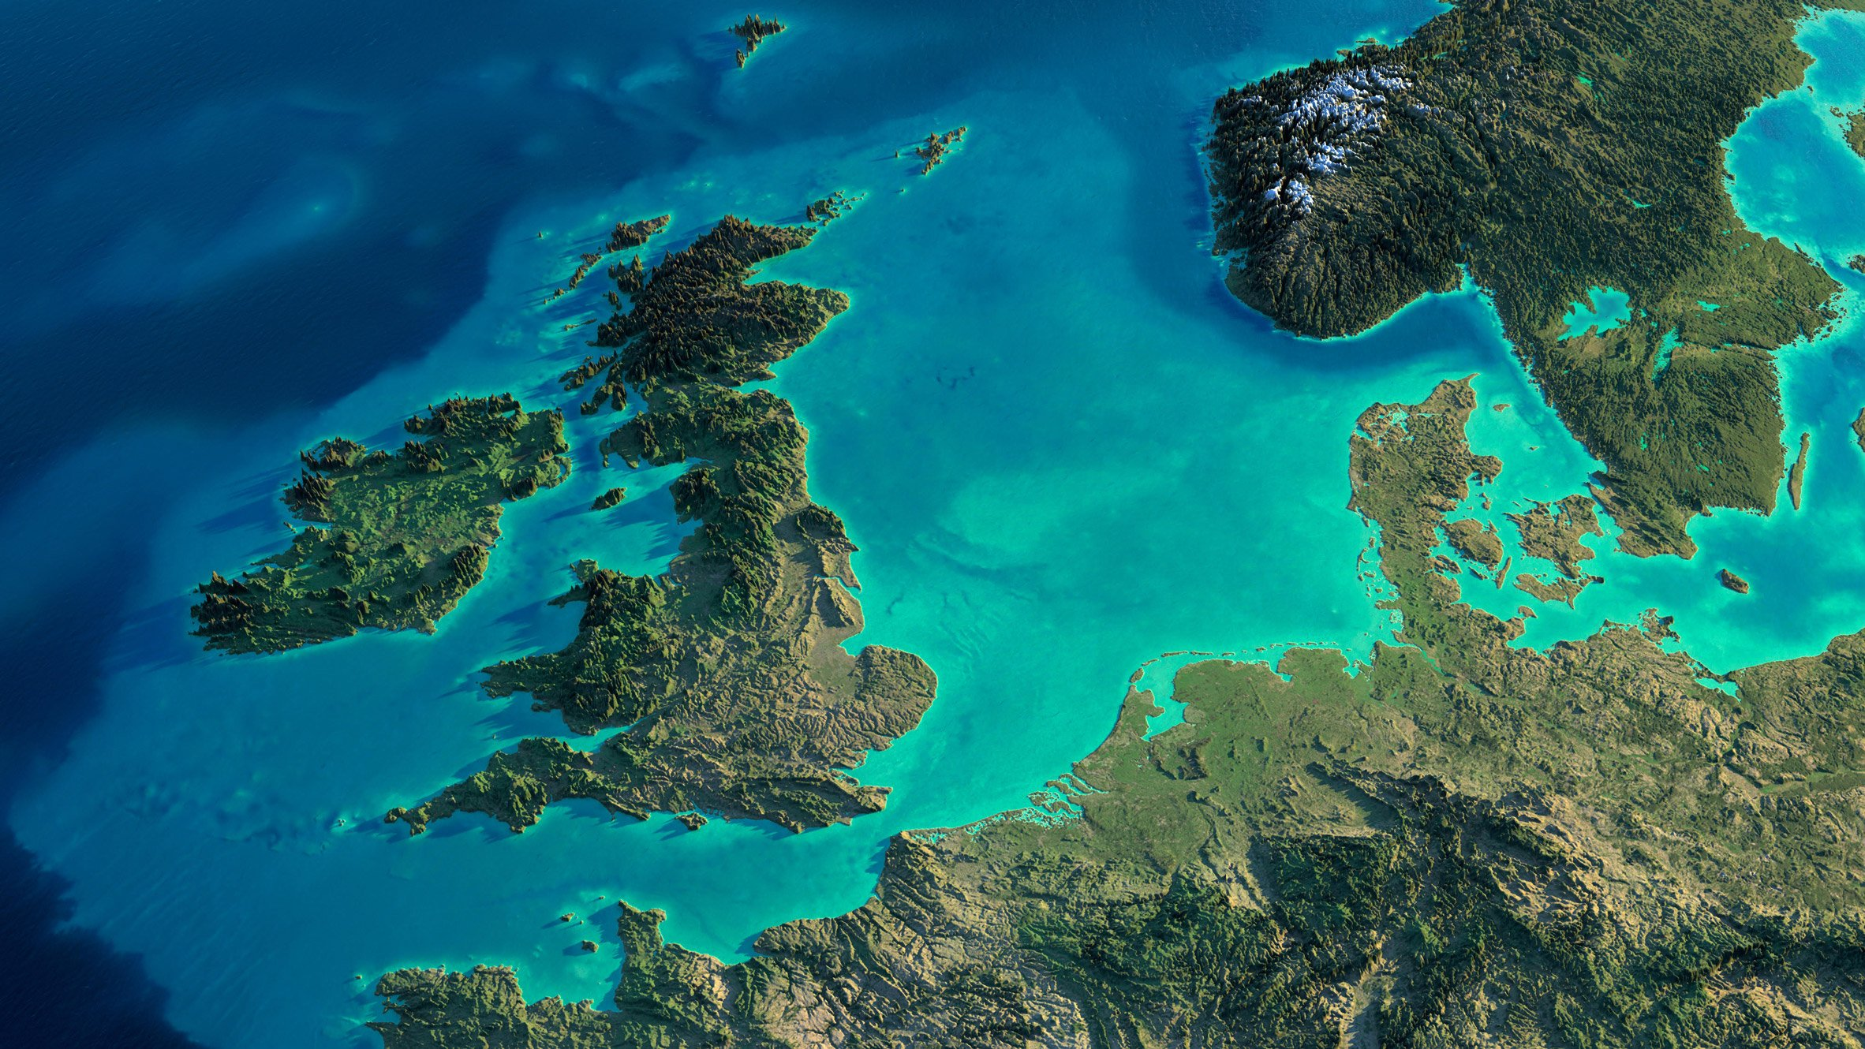
Add some text to the title slide
Replace with your own text
Notes:
What is relevant is what is happening above the North Sea. I have therefore collected air pressure data at the following locations::
HAMMER ODDE FYR, DENMARK
TORUNGEN FYR, NORWAY
WICK, UNITED KINGDOM
MAASTRICHT, NETHERLANDS
The variance between these four location I took as input for the model

Slide 7
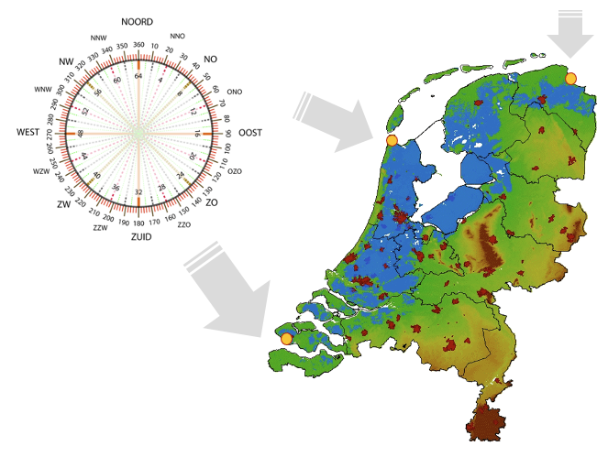
03
NORTH NORTHWEST
October to March
North and South
3 Locations
Notes:
The wind direction also determines whether a storm is dangerous for the Netherlands. North Northwest storm is seen as the most risky. I have collected data about the wind direction at three locations and each of these places has a different angle from which there is more threat.
…, …, … You can read it from the compass rose
By the way this map of the Netherlands also clearly shows where our country is below sea level. It is marked in blue how far the sea will reach in case of a monster flood. In the dark red you can see where most people live. This is about 11 million people. . Where the people live is not part of the model, strength of the wind and direction is

Slide 8
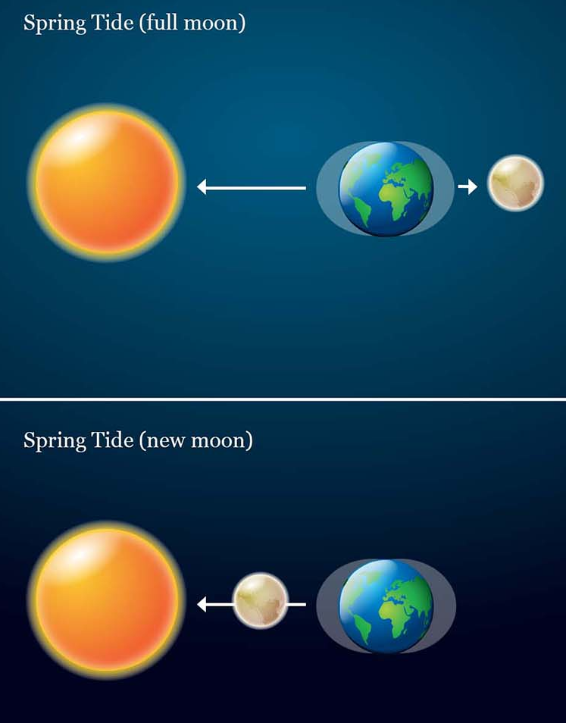
04
SPRING TIDE
Astronomical Tide
High tide by the moon
High tide by the sun
Notes:
Both the moon and sun try to pull the Earth's water mass. This creates a mountain of water in the oceans, passing by two times a day. So there is always ebb and flow, also in the North Sea.
Now, if the sun, earth and moon are in a straight line, the water mountain is extra high. The tides are then more extreme. We call that spring tide. Extra high tide

Slide 9
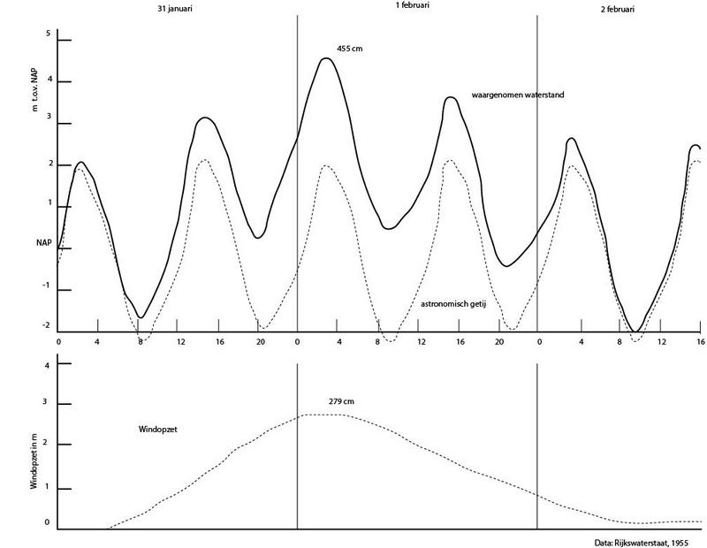
From the archive
Notes:
For a reason, there is no other country in the world that measures as many water levels as the Netherlands. Nowadays we've got digital and connected water meters every where along the coast and rivers.
But in the early days this was all done manually. Here you see a hand drawn graph from the archive. Special attention here for WATER SETUP which means the mountain of water on top of the regular tide … as a result of spring tide. This was the night of the disaster in 1953: small … it is mentioning 4m55 above the normal sea level. We call is NAP, or new amsterdam level
I tapped from meter readings for the same locations Vlissingen, Den Helder and Delfzijl
water setup

Slide 10
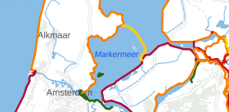
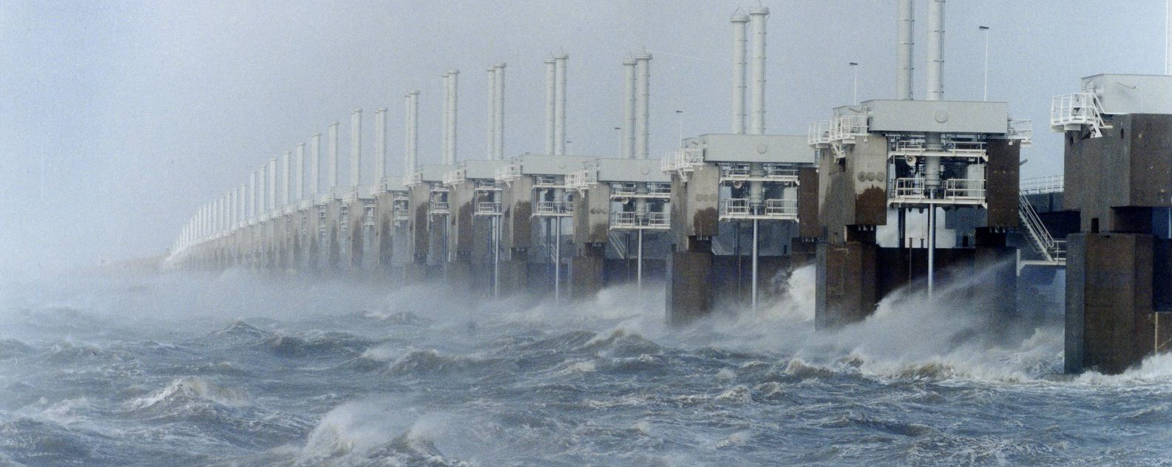
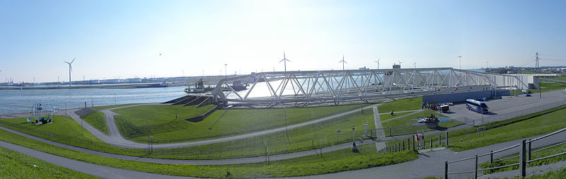
5. FLOOD DEFENSES
Dykes
Dams
Weirs
Infrastructures
Notes:
Our country has many weirs, dams and dykes. We cannot live without this protection
The disaster in 1953 was the start a mega project for constructing The Delta Works consisting of different types of flood defences:
In my model I use the data of the largest flood defenses as a target to calculate against. I took the data from OOSTERSCHELDKERING and the MAESLANTKERING When these barriers are closed due to storm, I have put in my model. And also from four more infrastructures
Hartelkering
Hollandsche IJsselkering
Haringvlietsluizen
Ramspol inflated at storm conditions

Slide 11
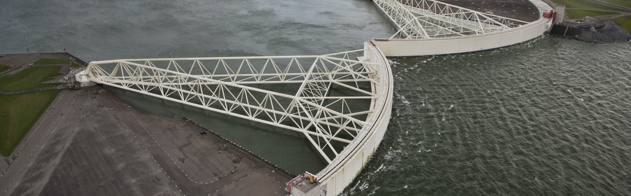
6. MONITORING
Operational data
Tidal measurements
Reporting and classification storm surges
Special thanks to WMCN
Notes:
Maintenance and monitoring is done by various organizations in the Netherlands, both locally and nationally. I myself work for a local organization, so not really relevant to my research. I have been in contact with Water Management Centrum Nederland for the national infrastructure. Here I requested information about the closing and opening of the flood defences. And also about the reports that are made of every serious storm.

Slide 12
PERFECT STORM
MACHINE LEARNING MODEL
STORMS
classification model
should I worry or not?
upscaled
worry_list = [osk, mlk]
and [vl, dh, dz]
graphs + timeline
01
Temperatures from the North and South of Europe are compared
02
NORTH SEA
Barometric pressure data from around the North Sea are compared
03
NORTH NORTH-WEST
Wind gust and wind directions are interpreted for three locations along the Dutch coast
04
SPRING TIDE
The highest high tide of each day is collected for the same locations
05
FLOOD DEFENSES
Operational data is collected from the moving infrastructure which protects the country
05
MONITORING
Which storm surges really impacted The Netherlands in the past 30 years?
Notes:
<SHEET>
There is so much to discover in the data … only scratched the surface
Upscaled: it doesn’t happen often that they close the weirs .. asked for, must cost a fortune to move MLK
TO BE Honest: there is also lot’s to improve … <NEXT> slide result of my model

Slide 13
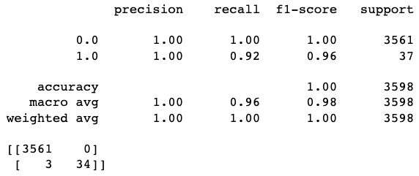
Classification Report
PERFECT STORM
1 = worry / close
3 times recall on 1
Room for improvement
Notes:
Confusion Matrix:
True pos 3561 False pos 0
False neg 3 True neg 34
0 = Type 1 error: predicted worry (1), but in fact was no worry (0)
3 = Type 2 error: predicted no worry (0), but in fact was worry (1)

Slide 14
THANK YOU

